Slide 1


APPLICATION SCORECARD
Introduction to Data Mangement and Pocessing(DS5110)
Team Members:
Rohan Ojha(002253450)
Prateeksha Devikar(002407443)
Zankhana Mehta(002320268)

Slide 2
CONTENT
01
Introduction
02
Problem statement
03
Our Solution
04
Deliverables
05
Conclusion

Slide 3
INTRODUCTION
01
Leveragining Machine learning Models:
As a part of our project we decided to use the real world lending club data and use ML models to build an application scorecard.
02
Risk assessment significance:
For platforms like lending club, accurately predicting the likelihood of loan repayment is critical. Effective risk assessment helps prevent losses, maintain investor confidence, and ensure the platform's long-term sustainability.
03
Data-Driven appraoch:
This project seeks to address these challenges by developing an automated application scorecard. Using machine learning, we aim to create a robust model that predicts the likelihood of default based on historical Lending Club data.

Slide 4


PROBLEM STATEMENT
Traditional methods
Need for Data-driven solution
Takes too long
Miss subtle patterns in data
Can be inconsistent across applications
Have higher rates of defaults
To address these issues, there is a need for an automated, data-driven approach that can assess applications more accurately and efficiently.

Slide 5


OUR SOLUTION
Development of a machine learning-based application scorecard that:
Processes historical loan data
Identifies key risk factors
Generates a credit score for new applications
Provides consistent, quick decisions
Key components:
Data visualization dashboard
Data preprocessing pipeline
Feature engineering
Model development and validation
Scorecard implementation

Slide 6
DELIVERABLES

Slide 7
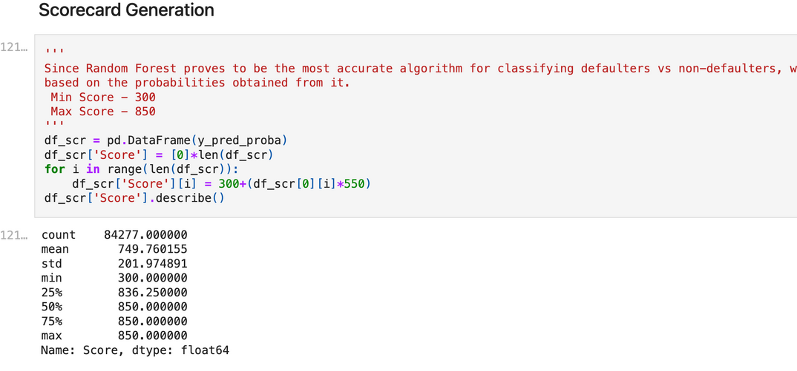
1.
APPLICATION SCORECARD
Outliers and missing values: Detected and managed to prevent skewed model results. Missing Values: Handled to ensure a complete dataset.
Correlation and VIF Analysis: Examined variable relationships to reduce multicollinearity and choose relevant features. Applied variance inflation factor analysis to detect highly correlated predictors, minimizing redundancy.
Conducted OOT(out-of-time) testing.
Model selection and comparison,Feature importance analysisModel performance metrics,Scorecard scaling

Slide 8
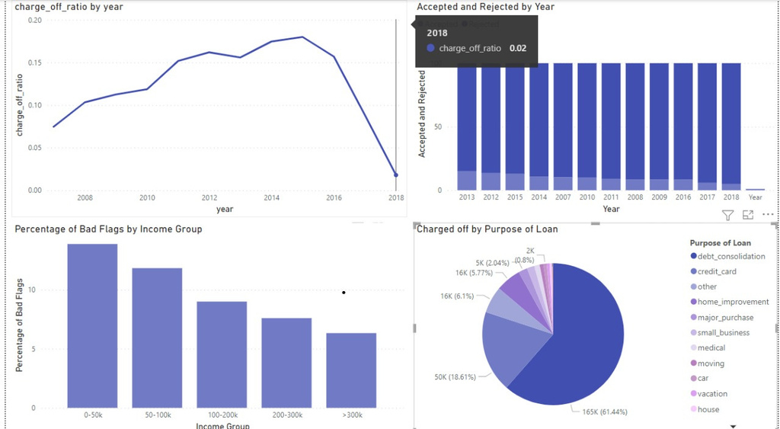
2. POWERBI VISUALIZATION
Initial data exploration conducted using PowerBI to provide an interactive visualization of dataset characteristics.
Key trends, including annual changes in the charge-off ratio were analysed.
Insights into borrower demographics, loan terms, and loan health.
The dashboard allows easy navigation through significant patterns, guiding model selection and improvement.

Slide 9
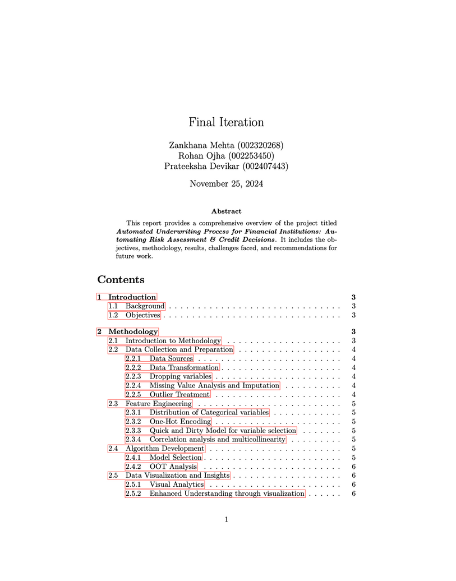
3. DOCUMENTATION AND PRESENTATION
Our team created a comprehensive report on Overleaf, documenting every step of the project. This report includes an in-depth discussion of our methodology, data preprocessing steps, feature selection processes, model selection, and evaluation metrics.
Presentation: This slide deck is designed as a high-level summary of our project, highlighting key insights without overwhelming detail. Each slide focuses on a crucial part of our project flow

Slide 10
CONCLUSION
01
Key Insights from the Scorecard
Variables like FICO Score and Debt-to-Income Ratio were found to be critical in predicting loan defaults.
Our model effectively identified applicants with a high likelihood of default, supporting better credit decision-making.
02
Real-World Impact
The application scorecard offers financial institutions a scalable, data-driven solution that improves the accuracy and speed of loan risk assessment, enabling proactive risk management.
03
Future Work
Exploring additional data sources and fine-tuning models to increase accuracy.
Testing the scorecard on a more diverse dataset to enhance generalizability.

Slide 11

THANK YOU
FOR YOUR ATTENTION

